Slide 1

OPPORTUNITIES
AND YOU
Presents
Influencer Marketing
Unleased

Slide 2
ABOUT ONU
Agenda
01
02
03
04
05
06
07
Your
Efforts
Members
Work role
About
Training
Member’s
Benefits
END
RESULT
ONU’s
Site

Slide 3
About ONU
Company Overview: "Opportunities And You" is a leading Influencer Marketing company that offers cost-effective services to businesses worldwide. They specialize in leveraging collaborating influencers to promote brands effectively.
Competitive Pricing: Stand out from competitors by providing services at an unbeatable cost. With less than 6 paise per impression, the company offers exceptional value to clients.
Holistic Solutions: The company's plans include not only influencer promotion but also free web designing and SEO services, providing clients with comprehensive and integrated marketing solutions. [Explain SEO and Web Designing]
Extensive Influencer Network: With a database of 10k collaborating influencers, "Opportunities And You" has the resources to reach diverse audiences across various industries.

Slide 4

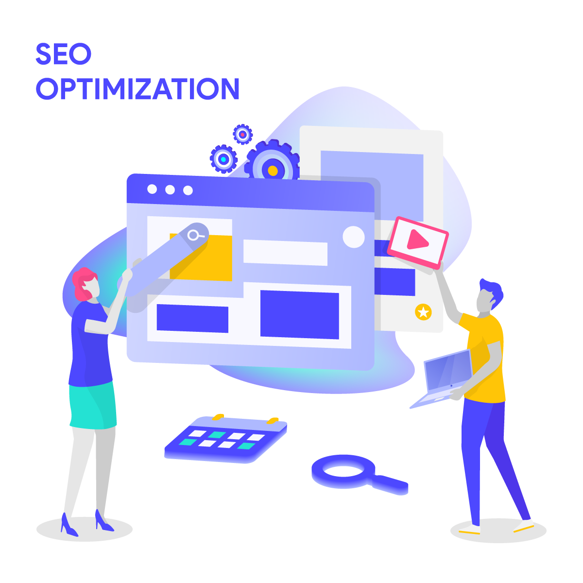
SEO
SEO stands for Search Engine Optimization. It is a set of strategies and practices aimed at improving a website's visibility and ranking on search engine results pages (SERPs). By optimizing various elements on the website and creating valuable content, SEO helps search engines understand the website's relevance to specific search queries. The ultimate goal of SEO is to attract organic (non-paid) traffic to the website, increase its online visibility, and reach a larger and more targeted audience.
Web Designing
Web designing is the art of creating attractive and user-friendly websites by combining visual elements and content for a seamless online experience.

Slide 5



SAMPLE VIDEOS

Slide 6



SAMPLE VIDEOS

Slide 7

Members Work role
SONU SHARMA
ASHISH KUMAR
PANKAJ MANDAL
ASHISH PANDIT
ROHIT KR. SHARMA
SEO,
WEB DESIGNING,
SOCIAL MEDIA COORDINATOR
SEO,
SOCIAL MEDIA
COORDINATOR
VIDEO EDITOR,
SOCIAL MEDIA COORDINATOR
GRAPHIC DESIGN
SOCIAL MEDIA COORDINATOR
GRAPHIC DESIGN

Slide 8
Training List for Trainees
Introduction to AI Technology: Understand the significance of AI in the present time and its practical applications in various tasks, including email writing, graphic design, video editing, and Influencer Marketing.
Effective Tele-calling Techniques: Learn essential communication skills and strategies to confidently interact with clients, building rapport and conveying information persuasively.
Graphic Design Fundamentals: Acquire the basics of graphic design, including layout, color theory, and design principles, to create visually appealing content for marketing materials.
Search Engine Optimization (SEO): Discover the key concepts and techniques of SEO to optimize website content and enhance online visibility, driving organic traffic.
Web Design Essentials: Master the essentials of web design, focusing on user experience (UX) principles, responsive design, and navigation to create user-friendly websites.
Video Editing Basics: Learn the fundamentals of video editing, including video cutting, transitions, and audio synchronization, to produce engaging promotional videos.

Slide 9

Training List for Trainees
Client Communication via Text/Chat: Develop effective written communication skills to engage with clients via text or chat, ensuring clear and concise messaging.
Continuous Learning Strategies: Understand the importance of ongoing learning and explore resources like YouTube and Google search to acquire new skills relevant to their work.
By following this comprehensive training list, our new trainees will be equipped with the necessary skills and knowledge to excel in their roles and contribute to the success of our Influencer Marketing company.

Slide 10
BENEFITS OF MEMBER
As we invite you to work with us, we understand that you seek valuable benefits from your association with our company. Working with "Opportunities And You" provides numerous advantages that can enhance your professional journey:
Accelerated Career Growth: Instead of investing years in acquiring degrees and experience, collaborating with us for a short period (2-3 months) provides an excellent opportunity to fast-track your career. "Opportunities And You" offers a remarkable platform for you to showcase your skills and talent, enabling you to carve a successful career path.
Skill Enhancement: Working with us opens doors to accessing new technologies and courses, enriching your skill set. Even during a short-term engagement, you can gain valuable knowledge and expertise that will benefit your freelancing endeavors and future professional pursuits.
Networking Opportunities: Joining our team provides you with access to a diverse network of industry professionals and influencers. Collaborating with like-minded individuals can lead to potential partnerships, referrals, and new opportunities in your chosen field.
Showcasing Your Abilities: "Opportunities And You" gives you the chance to demonstrate your capabilities to a wide audience. Through impactful projects and campaigns, you can leave a lasting impression, boosting your credibility and visibility in your field of expertise.

Slide 11

BENEFITS OF MEMBER
Flexible Working Arrangements: We understand the importance of work-life balance. While working with us, you can benefit from flexible arrangements, empowering you to manage your time efficiently and take on projects that align with your schedule and preferences.
As we invite you to work with us, we understand that you seek valuable benefits from your association with our company. Working with "Opportunities And You" provides numerous advantages that can enhance your professional journey:

Slide 12
EFFORTS
Meaningful Impact: Your efforts directly impact the success of "Opportunities And You," contributing to our growth and reputation in the industry.
Driving Progress: By dedicating yourself to our projects, you play a vital role in driving company growth and achieving our goals.
Enhanced Portfolio: Working with us allows you to showcase your skills, building a strong professional portfolio for future opportunities.
Practical Experience: Gain valuable experience in Influencer Marketing, honing your expertise and making you more competitive in the market.
Personal Growth : Your involvement fosters personal growth, improving communication, teamwork, and overall development.

Slide 13

A BEAUTIFUL STORY BASED ON “EFFORTS”
In a lush green meadow, there lived a curious little turtle named Timmy. He dreamt of exploring the world beyond his comfortable shell. One day, he saw a group of colorful butterflies fluttering gracefully, and he was mesmerized by their beauty and freedom. Determined to fly like them, Timmy asked the butterflies for advice. They kindly told him that flying required effort and practice. Undeterred, Timmy decided to give it a try. He started flapping his tiny legs with all his might, hoping to take flight. At first, Timmy's efforts seemed in vain as he could barely lift off the ground. But he didn't give up. Every day, he practiced harder and harder, determined to achieve his dream of flying. As days turned into weeks, Timmy's legs grew stronger, and his determination soared higher. One sunny morning, as he flapped his legs with all his might, he felt a gentle lift. Timmy was flying, albeit a few inches off the ground! Ecstatic with his newfound ability, Timmy continued his efforts. With each day, his flying skills improved, and he soared higher and higher. The other animals in the meadow cheered him on, amazed by his perseverance. Finally, the day came when Timmy glided through the sky like a true butterfly. He danced among the clouds, feeling the wind beneath his wings. His dream had come true, thanks to his unwavering efforts. The moral of the story is that with determination and effort, even the most impossible dreams can become a reality. Just like Timmy, we should never give up on our aspirations and keep trying until we achieve success. Effort is the key that unlocks the door to our dreams, no matter how big or small they may be.

Slide 14
END RESULT
The company "Opportunities And You" offers members a remarkable platform to showcase their skills and talents. Through short-term collaborations, they fast-track their careers and gain access to new technologies and courses, enriching their skill set. The company fosters personal growth, providing networking opportunities and flexible working arrangements. Working with "Opportunities And You" empowers members to build a strong professional portfolio and realize their dreams, just like Timmy the turtle, with determination and effort leading to success.

Slide 15
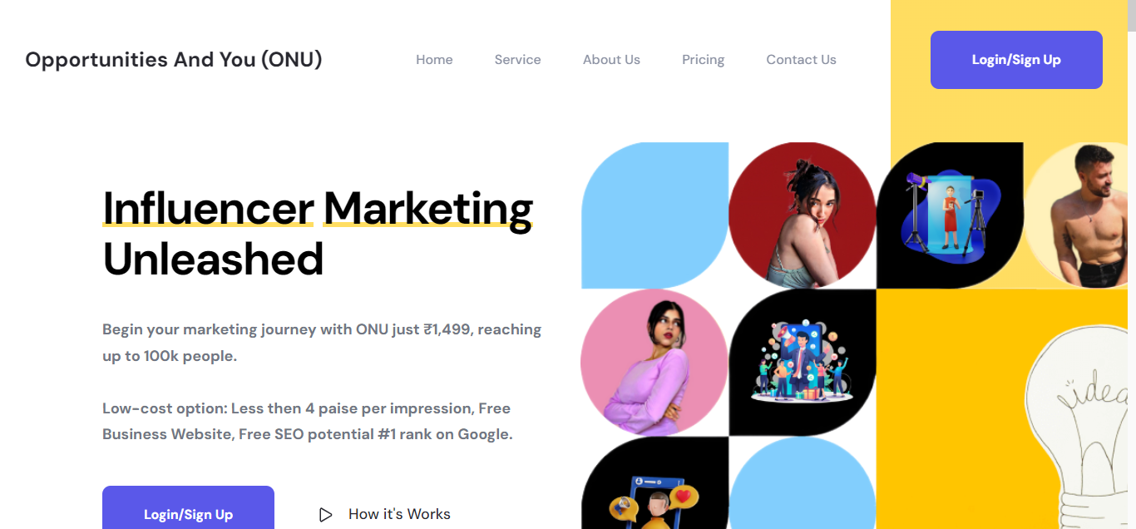
VISIT US!
ANY QUESTIONS?

Slide 16
THANKS!
Do you have any questions?
support@opportunitiesandyou.com
+91 620 4425328
opportunitiesandyou.com/

